Slide 1


Slide 2

Git & GitHub
Crash Course
Course Head: Roshan Lamichhane
Course Conducted by: Tech Club, PU

Slide 3
The Need of version control
What exactly is version control system?
Is it helpful?

Slide 4

What is Git ?
Git is a free and open source distributed version control system designed to handle everything from small to very large projects with speed and efficiency.
In simple words, it is a content manager, to track the changes that has been made in the content.
Git was created by Linus Torvalds in 2005 for development of the Linux kernel, with other kernel developers contributing to its initial development.

Slide 5


Slide 6

What is GitHub?
GitHub is a company that provides hosting for software development version control using Git. It is a subsidiary of Microsoft.
It offers all of the distributed version control and source code management (SCM) functionality of Git as well as adding its own features.
It provides access control and several collaboration features such as bug tracking, feature requests, task management, and wikis for every project.
A user must create an account in order to contribute(publish) content to the site, but public repositories can be browsed and downloaded by anyone

Slide 7
Content of this crash course
Installation of git
Setting up git
Creating GitHub account
Basic git commands
Exercises

Slide 8
Git installation and GitHub account
…….

Slide 9
We shall be using Git-Bash for most of the time.

Slide 10
Obvious Fact
The version control of git is done with git, itself.

Slide 11
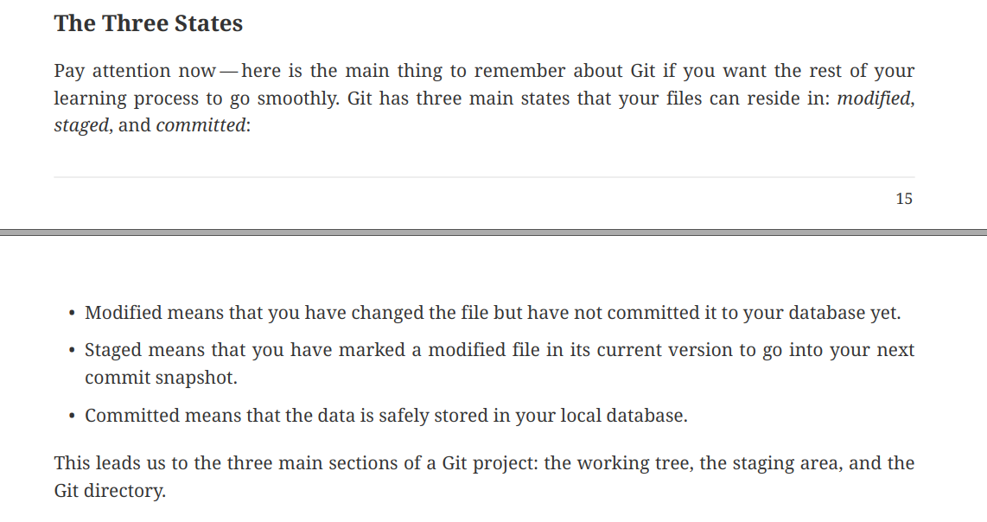
The Three States

Slide 12
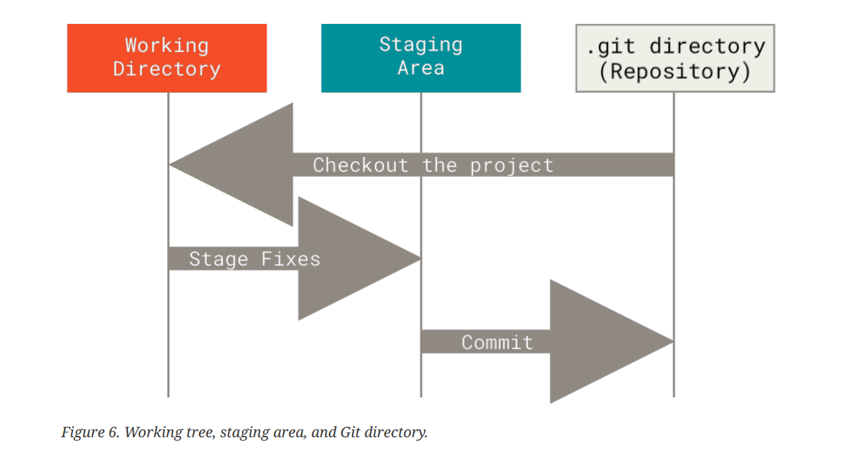

Slide 13
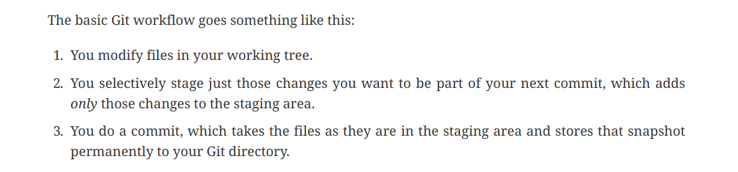

Slide 14
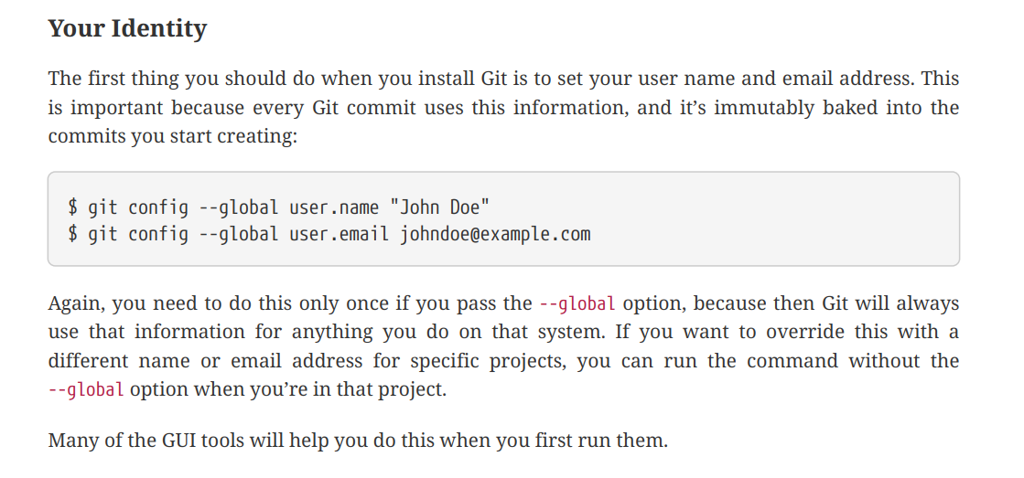
Back to Git-setup

Slide 15
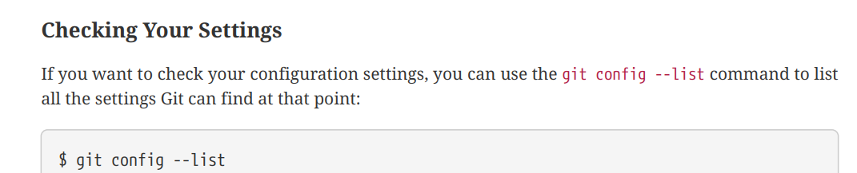
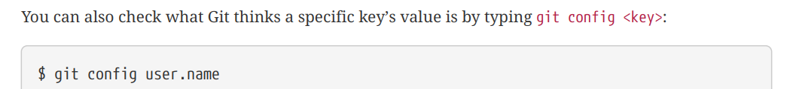

Slide 16
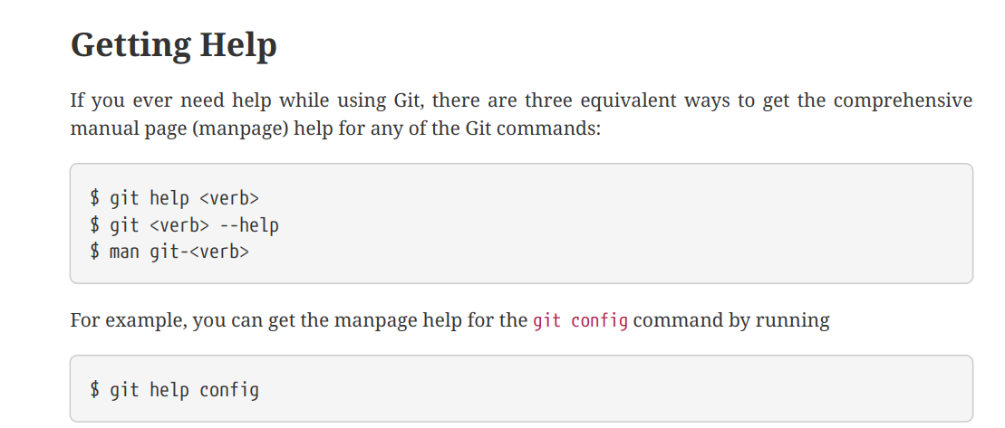
Command-name

Slide 17
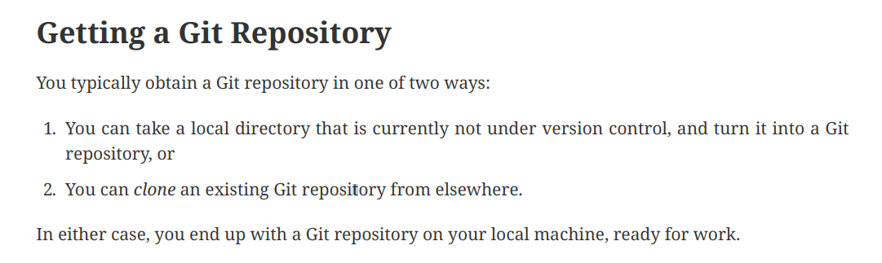

Slide 18
Initializing a Repository in an Existing Directory
We have a folder, say ‘xyz’
We open git-bash from that folder
And type:
git init
This creates a new subdirectory named .git that contains all of your necessary repository files — a Git repository skeleton. At this point, nothing in your project is tracked yet.

Slide 19
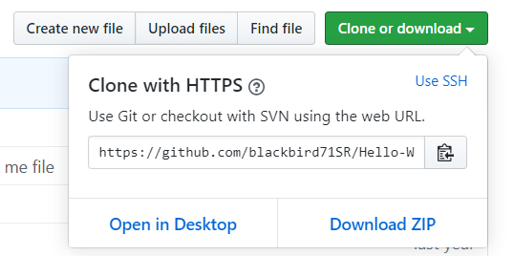
Cloning an existing git repository
In such case, we take an example of cloning an existing repository from GitHub
We use the command ‘git clone’ in such cases.
For example:
git clone <url>
We will be using https

Slide 20
Lets add some file(s)
Create a file named ‘main.c’ and write some code to it.

Slide 21
Checking the status of your files
The main tool you use to determine which files are in which state is the ‘git status’ command.
git status

Slide 22
Staging files
Now, the output will indicate that there is untracked file.
Before a commit can be done, the required file should be added to staging area.
To do so:
You can run ‘git add <file-name>’
In this case, it becomes as:
git add main.c

Slide 23
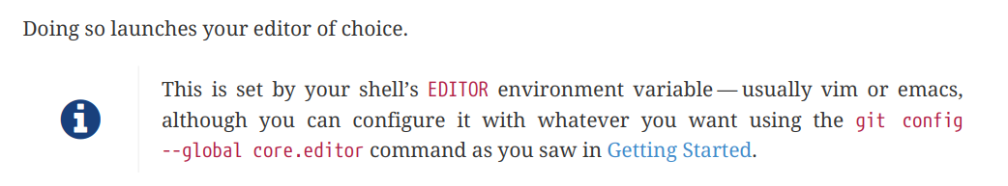
Committing your changes
Now that we have staged our file to be committed.
A commit action can be performed as:
git commit
Several parameters can be added to
this basic command. We will see to
that in our next exercise.

Slide 24
Commit history - log
In git, it is possible to see the history of all the commits.
It can be performed as :
git log
It gives a detailed output. To shorten the each log to one line, we can use this command :
git log --oneline
More parameters can be added
to format the output as desired.

Slide 25
Lets add another file and do some editing
Add another file, say ‘xyz.c’ and write to it
You may write to the other file ‘main.c’ as well.
Now,
Run a ‘git status’ and watch the output.
It shows xyz.c as untracked.
Note: You can chose which files to track and which not to.

Slide 26
Now lets compile these .c files
After compiling, we can see the .exe and .o files of respective source codes.
In the long run, it is unnecessary to track such .exe , .o and other files.
So, we can choose not to track such files.

Slide 27
Ignoring unnecessary files - .gitignore
Often, you’ll have a class of files that you don’t want Git to automatically add or even show you as being untracked. These are generally automatically generated files such as log files or files produced by your build system. In such cases, you can create a file listing patterns to match them named .gitignore.
Steps:
Create .gitignore file
Add the list of file names which you don’t want git to track them
Example :
Live demo is in process ;)
Note: All the files mentioned will not be tracked. One can use wildcards to ignore large set of files.

Slide 28
It is healthy to run ‘git status’ command all the time to view the states of files.
Even if not mentioned in the slides, please see for yourself.

Slide 29
After the unnecessary files are mentioned in .gitignore, they are not showed in the ‘git status’ output.
The only files which are not tracked are .gitignore and xyz.c
If the ‘main.c’ was modified then it will be shown as modified.
Yeah, you have to track .gitignore file.

Slide 30
Lets add these files to the staging area.
Ways to do :
You can run ‘git add <file-name>’ for each file
Or,
You can use a command to add them all to staging area at once.
git add --all
It is same as :
git add -A
Just liked said before, keep using ‘git status’ command all the time.

Slide 31
One more thing, before commit
Let’s wait a minute before heading towards doing a second commit.
Say that we wish to see what changes were done to the file.
In such case , we use :
git diff --staged <file-name> for specific file
git diff --staged for whole project
‘-- staged’ is used because the files have been staged.
No need to use ‘--staged’ if the files haven’t been staged yet.
0

Slide 32
Doing a commit
Now lets run a ‘git status’ command quickly and observe the output.
Instead of opening a text editor to input commit message, we can embed it in command form as:
git commit -m “Commit message”
Now, lets see the log using the command
git log
0
0

Slide 33
git log
Several parameters can be added to the basic ‘git log’ command to format the output as required.
Parameter | What does it do?
--oneline | Shortens the log of each commit to single line
--graph | Shows in graph format, i.e shows links between commits
--stat | Shows detailed log
-p | Shows even more detailed log, including changes brought in each commit
--reverse | Shows log in reverse order, oldest…latest
--all | Shows sequential log with commits from all branches
And many more
Note: Several parameters can used at once. Example: live demo!

Slide 34
A little information
If there exists another command for the same operation, git will show you how the same operation can also be performed by another command.

Slide 35
git blame
‘git blame’ is command to see the all changes that has been made in a specific file.
It can be done as
git blame <file-name>

Slide 36
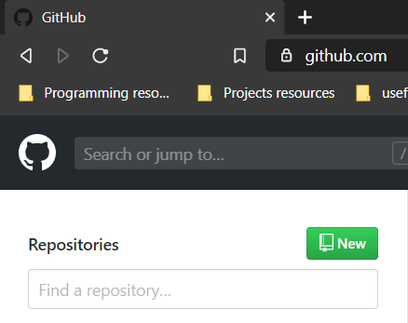
Working with Remotes
Remote repositories are versions of your project that are hosted on the Internet or network somewhere.
We will be uploading our local repository to GitHub.
Let’s create a blank repository on GitHub

Slide 37
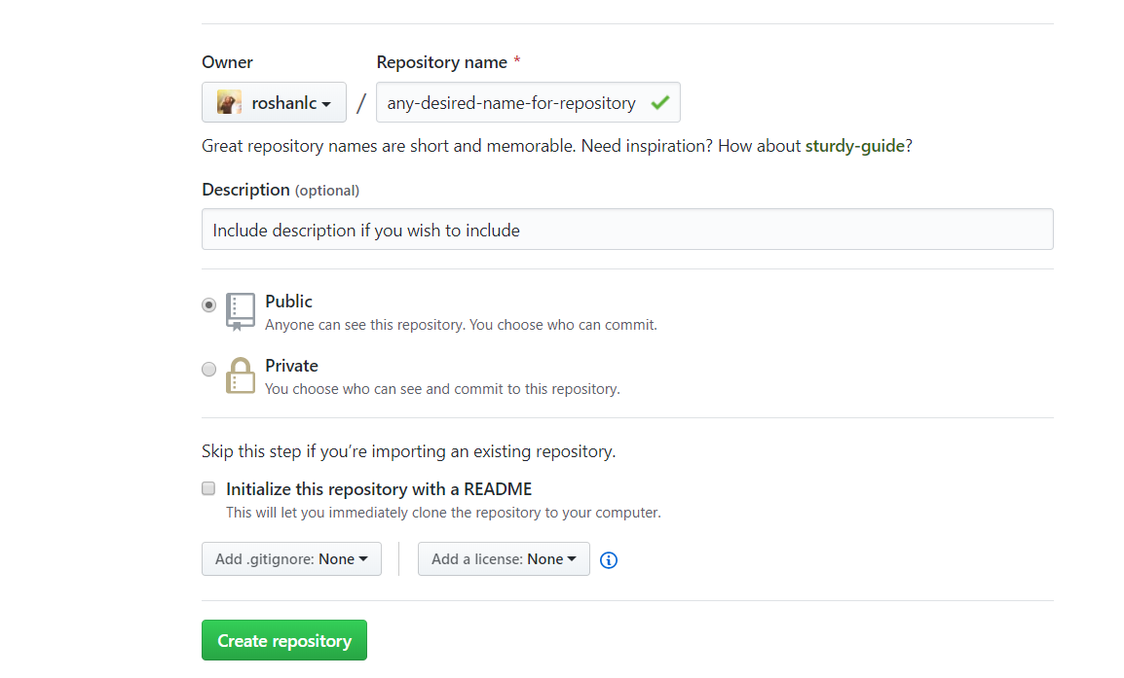
Example:

Slide 38
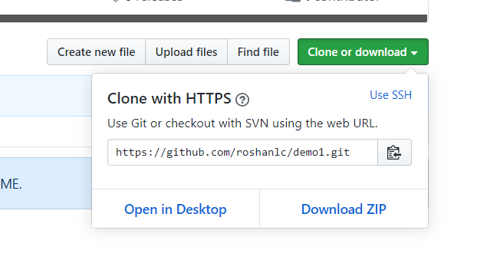
We will be uploading our local repository to this GitHub hosted repository.
So copy the link (.git link)

Slide 39
Uploading to remote repository
In such cases, the ‘git remote’ command is used with its several parameters.
Run a ‘git remote’ on git-bash.
There will be not output since we have not configured remote repository with this local repository yet.
Note:
‘git remote’ will show the list of remote repositories.
‘git remote -v’ will also show list of remote repositories but with their respective links.

Slide 40
Creating git remote configurations
We use the following command to configure remote repository:
git remote add <name> <url>
In our case, it becomes as:
git remote add <any-name-for-remote> <recently-copied-.git-link>
After this, run ‘git remote’ and ‘git remote –v’.
There is now some output, since we have now configured a remote repository

Slide 41
Pushing your commits to remote repository
Now, lets push(upload) the local commits to remote repository.
We use
git push <remote-name> master
While pushing, a dialogue may prompt
asking for GitHub credentials
Now if the push was successful, your local repository is now on remote
server as well.
It is an exact replica of your local repository persevering all the things.
Here master is the branch we wish to upload.
We will discuss about branches in next topic.

Slide 42
Inspecting a Remote
To see in-depth details about a remote, we use ‘git remote show <remote-name>’ command.
Example: live-demo, and do for youself

Slide 43
Making changes in remote repository
Instead of making changes in local repository and then uploading them to remote repository,
Lets make a change in remote repository and pull(download) it to our local repository.
Steps:
Make a change in remote repository, i.e github repository.
Commit the change.
Example: Live demo
After this point, there will be 3 commits on remote repository while there are still 2 commits on our local repository.
On such cases, one should make the local repository synchronized with remote repository, before doing any other commits.

Slide 44
Pulling changes from remote repository
Lets run ‘git remote show <remote-name>’ to see changes about remote repository.
It shall say that local is out of date, which means local repository is behind remote repository.
Now to pull changes to local repository, run
git pull <remote-name> master
After this run ‘git log’ and there shall be three commits shown,
which means successful pull was performed.
Here, master is the main branch, to which all changes will be synchornised.
We will discuss about branches in next topic.

Slide 45
Branching & Merging
The necessity of branches :
And how is merging perfomed:
Merge types: FAST-FORWARD MERGE, TWO-WAY MERGE
Explanation on whiteboard!
How ‘git status’ and ‘git log’ work for branch :

Slide 46
Creating a branch
A branch can be created using command:
git branch <branch-name>
To see the list of all branches, we can run :
git branch or git branch --list
These commands show only the local branches
To see both local and remote branches, run git branch --all
To get even more detailed info about local and remote branches
git branch -av

Slide 47
Switching to a branch
To make changes to a branch, it should be checked out or switched to.
To checkout a branch, we can run:
git checkout <branch-name>
Or,
git switch <branch-name>
Both are equivalent!

Slide 48
Deleting a branch
To delete a branch, you must be on ‘master’ branch.
Now, you can delete a branch as :
git branch –d <branch-name>
It is safe method as it only allows a merged branch to be deleted.
To delete a branch forcefully, say an unmerged branch then, we use:
git branch –D <branch-name>

Slide 49
Make some changes in a branch
Firstly, switch to a branch as ‘git checkout <branch-name’ or ‘git switch <branch-name>’
With the required branch switched to, make some changes in any file.
For now, I shall be changing ‘main.c’ file.
Always perform ‘git branch’ or ‘git status’ to
check if you are really on the required branch.
Note: * Will be placed before the checked out branch
Just liked said before, keep using ‘git status’ command all the time.

Slide 50
Lets commit a change in branch
After making a change, add the file(s) to staging area.
And perform a commit with some commit message.
Now, run ‘git status’ and ‘git log’ on current-branch at first.
Then, run ‘git status’ and ‘git log’ on master branch.
We can see that our branch is ahead of local-master and remote repository
Master branch should be checked out before running commands for master branch.

Slide 51
Performing a merge
In such cases, where master branch has not changed but only the branch has changed, we perform a fast-forward merge.
Actually, git does all the work for you. You just need to type in some commands.
**Note: Before performing any merge, you must be on master branch.
We can see list of branches which have already been merged by:
git branch –merged
Here, we can see that only master is shown, which no means no other branches have been merged to master

Slide 52
The branch is not merged with master branch yet.
A merge can be performed in such(fast-forward cases) as:
git merge <branch-name>
It will output the changes, and will say ‘Fast forward’
Now run ‘git log’ and ‘git status’ on master.
Run ‘git branch --merged’ and the branch-name is listed there.
Our master is up-to-date with local branch, but the remote repository is still behind

Slide 53
Pushing branch(es) to remote repository
Now that we have a branch, how about pushing it to remote repository.
There can be cases where one needs to push master along with other branches.
It can be done as:
git push <remote-name> --all
To push only a specific branch, we use:
git push <remote-name> <specific-branch-name>

Slide 54
Deleting the merged branch (local repo)
To delete the merged branch on local repository, it can be done as :
git branch –d <branch-name>
**Note: You must be on master branch to do so.
Now that we have deleted merged branch on local repository.
We can also delete the branch at remote repository as:

Slide 55
Deleting branch in remote repository
To delete branch in remote repository we run:
git push <remote-name> --delete <branch-name>

Slide 56
git fetch
To just download whereabouts of remote repository, we can run:
git fetch <remote-name>

Slide 57
Create another branch
Create another branch.
In this case, we will edit and commit changes on both master and newly-created branch.
Merge performed in such cases is known as two-way merge.
It will produce merge-conflicts since both master and branch have been edited.
We will resolve the conflict and perform a successful merge.
Firstly, checkout the branch and commit a change.
Afterwards, checkout the master branch and commit a change.
Lets edit ‘xyz.c’ file on both branches
A shortcut: To create and checkout a branch at once:
git checkout –b <branch-name>

Slide 58
Merge conflict(s) and resolving it
Now that we edited same file on both branches and committed changes.
Lets run ‘git log --color --graph --all --oneline” on master branch
We can see the deviated branches.
To merge, lets run ‘git merge <branch-name>’ and see what happens.
It will tell that automatic merge failed. It says to resolve the conflict and then perform a commit.
Now, open the xyz.c file and you will see contents from branch mixed up with it.
How to resolve such a conflict, live demo!

Slide 59
Now, we edit the xyz.c file as necessary, which changes to keep and which not to.
And then we stage the file and commit a change in master branch.
Now merge conflict is resolved and merge was successful.
Run ‘git branch --merged’ and this merged branch will be listed there.
Run ‘git log --color --graph --all’ to see who merged was performed.
Explanation on white board!

Slide 60
Reverting back: git revert
For this case we will be using ‘git revert’ command.
What does git revert do ?
It performs a commit to nullify the previous commit
It can be performed as:
git revert HEAD
Generally, HEAD is the pointer to the latest commit on currently checked out branch

Slide 61
Moving back to certain commit: git reset
Git revert is generally helpful to move back to one commit below latest commit.
When there arises a need of moving back to a certain commit, we use ‘git reset’.
git reset MODE COMMIT

Slide 62
Mode | Action
--soft | does not reset the index file or working tree, but resets HEAD to commit. Changes all files to "Changes to be commited"
--mixed | resets the index but not the working tree and reports what has not been updated
--hard | resets the index and working tree. Any changes to tracked files in the working tree since commit are discarded
Example:

Slide 63
Random stuffs!

